Slide 1
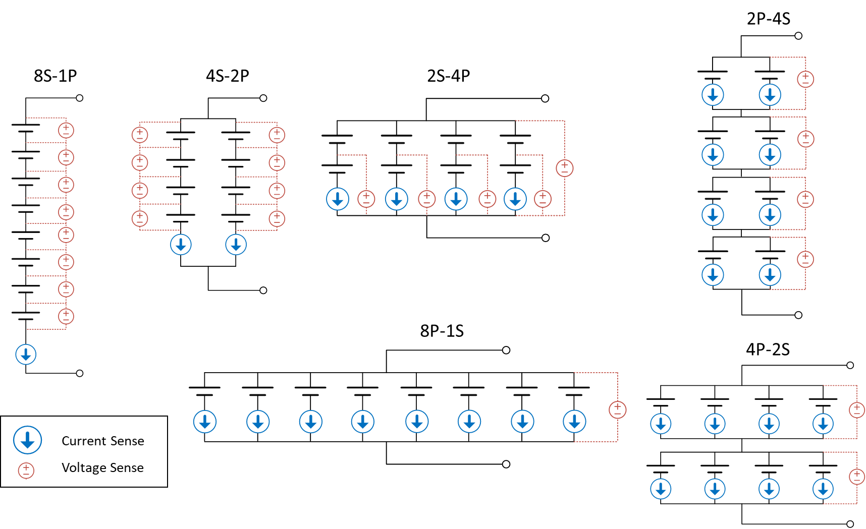
How to number the cells: top to bottom (positive terminal to negative terminal) and left to right, until a new node is encountered
1
2
1
3
4
1
5
1
3
5
7
2
2
6
2
4
6
8
3
5
6
3
7
4
4
8
5
7
8
6
7
8
1
2
3
4
5
6
7
8
1
2
3
4
5
6
7
8

